Slide 1

Data Hiding Tool
Guided By :
Rizwan Ur Rahman

Slide 2
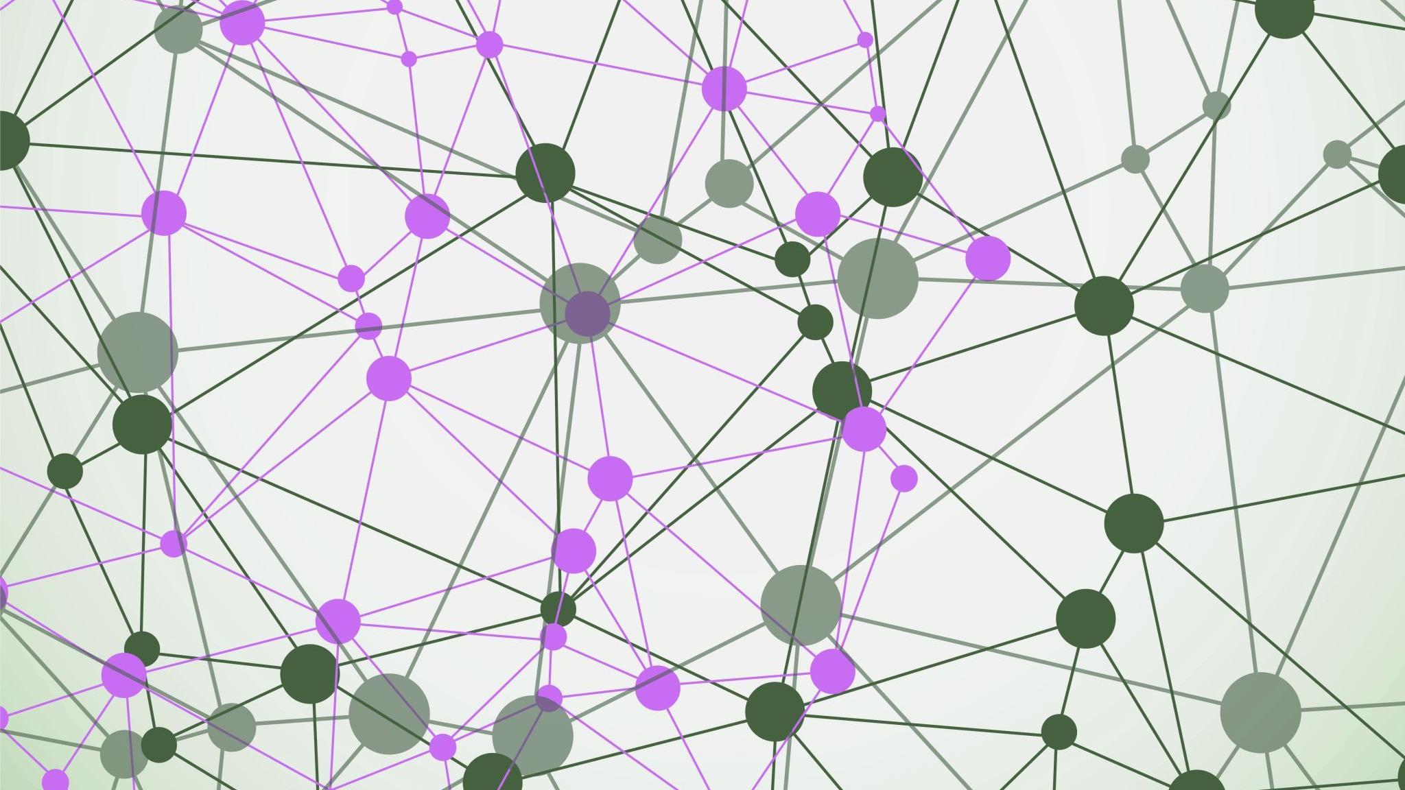
Introduction
Nowadays, one’s digital information or data is crucial for all whether for an individual or an organization, and Data Hiding is the practice of protecting that information from unauthorized access, or theft throughout its entire lifecycle by hiding it using different means of techniques.
Some of them are cryptography, steganography, hashing, tokenization, and many more which protect and hide data across all applications and platforms.
This project will combine two of the above-mentioned techniques i.e., cryptography and steganography to make an encryption algorithm for a messaging web app that will provide double-layer security to the user's conversations on it.

Slide 3

Cryptography
Cryptography is the study of secure communications techniques that allow only the sender and intended recipient of a message to view its contents. The term is derived from the Greek word kryptos, which means hidden.
Types of Cryptography: -
Secret Key Cryptography or Symmetric key cryptography.
Public Key Cryptography or Asymmetric key cryptography.
We are using AES (Advanced Encryption Standard)-256 encryption algorithm which is a type of symmetric block cipher, which uses a single key for both encryption as well decryption.

Slide 4

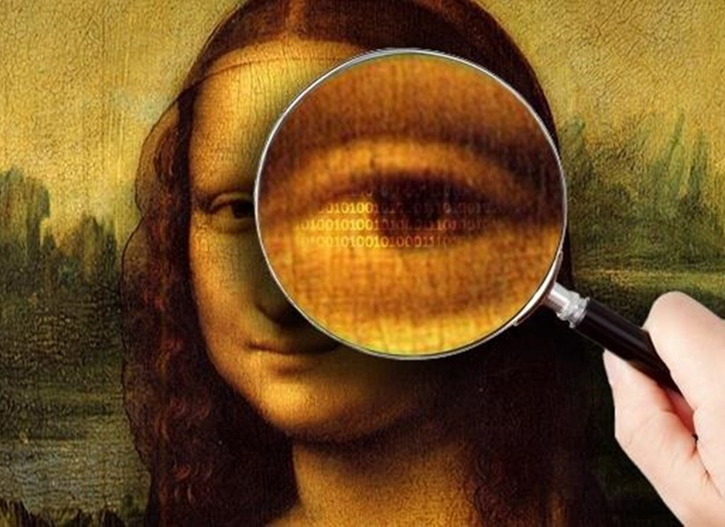
Steganography
Steganography is the technique of hiding secret data within an ordinary, non-secret, file or message to avoid detection; the secret data is then extracted at its destination.
Types of Steganography: -
Text steganography.
Image steganography.
Audio steganography.
Video steganography.
Network or protocol steganography

Slide 5


We are using Image Steganography which is a process of concealing data within an image file. The image chosen for this purpose is referred to as the cover image, and the image obtained after steganography is referred to as the cover image.
Combining steganography and cryptography is the most effective way to hide a message from adversaries while still protecting it if it is discovered.
This Photo by Unknown author is licensed under CC BY-NC.

Slide 6

Problem statement/Objective
Problem — There are many messaging apps and web apps available which uses cryptography for encrypting user's conversations but there is hardly any open-source tool which uses a combination of both cryptography and steganography .
So, the objective of this project is to create a web app that not only encrypts data conceals does not only on encrypts data but conceals it as well. This will enhance the level of security of the user’s conversations.
Therefore, even if someone gathers the data, firstly he will have to identify that something discrete is hidden inside it and even if he does this then he will have to decrypt it as well to get the original confidential data so this whole process will be very difficult to execute, and time taken.

Slide 7

Proposed Work
The user will be asked to enter the message and then after obtaining the message it will be encrypted with the AES-256 algorithm after the encryption it will be concealed in an image using image Steganography and then, it will be sent to the intended recipient.
Encryption and decryption of messages will be an automated and backend process, and only the receiver will get the original text.

Slide 8

Literature Review
There are a few Apps that use the same concept. Like WhatsApp which is an end-to-end encrypted messaging application, also signal also works on the same concept of encrypting the user data and storing it in the form of hashing and decrypting it afterward. s. Most of these applications work majorly on Cryptography but not on Steganography.

Slide 9
TIMELINE
Explaining the idea and architecture of the tool.
Review 1
Demonstrating a working prototype of our tool
Review 2
Demonstration of the final tool with Project Report.
Final Review

Slide 10
Team Members
Yogesh Kumar 19BCY10026
Suryakamal Jain 19BCY10071
Parth Chauhan 19BCY10083
Aditya Chouhan 19BCY10085

Slide 11

THANK YOU

